Slide 1
Department of Health and Human Services Division of Public and Behavioral Health Legislative Committee on Health Care
Brian Sandoval, Governor
Richard Whitley, Director
Cody Phinney, Administrator
Leon Ravin, MD, Acting Chief Medical Officer
March 23, 2016

Slide 2
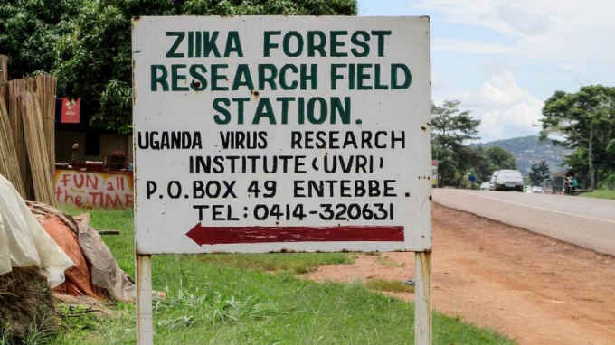
Overview of Zika Virus (ZIKV)
Arbovirus (Flavivirus) related to:
West Nile Virus (WNV), Dengue, Yellow Fever, Chikungunya
A viral disease primarily spread through bites from infected Aedes mosquitos:
A. aegypti
A. albopictus
Origins in Africa:
1947: Zika Forest in Uganda, isolated from
rhesus monkeys
1954: First human cases confirmed in Nigeria
Capable Global Traveler:
1951 to 1981: Antibody testing reveal evidence of human exposure.
West Africa/Central Africa eastward
Central Asia and Asia eastward
Pacific Islands eastward

Slide 3
Geographic Extent of ZIKV: ‘47 to ‘06
In spite of this slow eastward migration over 50 years, up to ‘07 there were only 14 documented cases of ZIKV illness within humans.
Two Lineages:
African
Asian

Slide 4
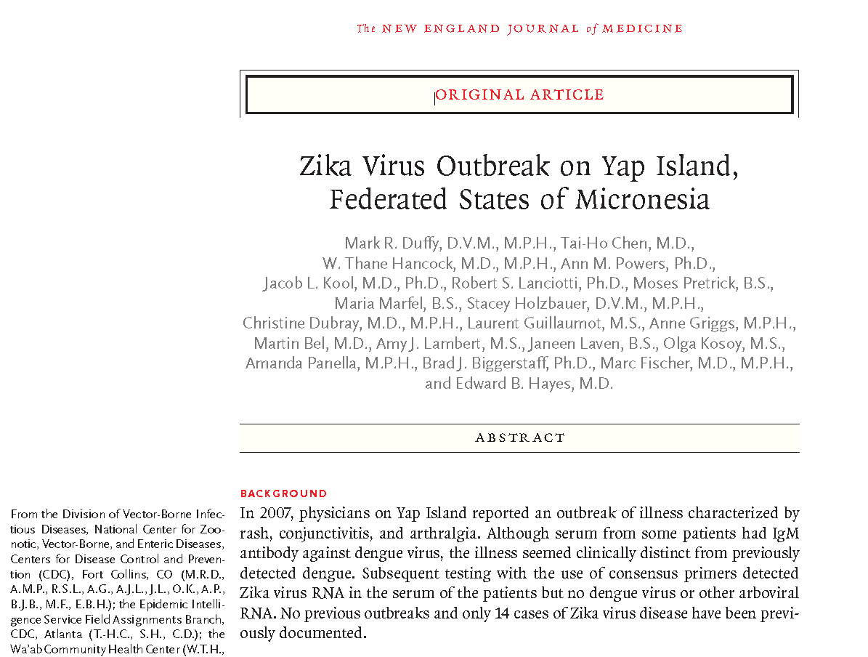
Yap Island Outbreak: ‘07
Who: ~7,000 citizens
What: Asian lineage,
73% of residents aged >3 years had recently been infected
18% had clinical illness
185 Cases (26% confirmed, 32% probable)
Where: Federated States of Micronesia in the western Pacific, Yap Island, in 9 out of 10 municipalities
When: April 2007 through July 2007
Why: Possibly introduced through a viremic human traveler from the Philippines
How: Vector primarily identified was A. hensilli mosquito
New England Journal of Medicine 360;24: June 11, 2009

Slide 5
Eastward Across the Pacific:’13 to ‘14
French Polynesia
New Caledonia
Yap
Cook Islands
Vanuatu, Fiji
Soloman Islands
Easter Island

Slide 6
The French Polynesia Outbreak: ‘13
Largest ZIKV Outbreak in Humans up to ‘13:
28,000 people symptomatic and accessed medical care
If we apply the 1/5 Rule: 140,000 were infected
140,000 = 51% of the population
Asian Lineage
Potential Vectors:
A. aegypti
A. polynesiensis
CDC’s Emerging Infectious Diseases (EID)
Vol. 20, No. 6, June 2014

Slide 7
ZIKV’s Arrival to the Americas: ‘14 – ‘15
Retrospective Studies:
World Cup import (6/14 and 7/14)?
Polynesian team at Aquece Rio Int’l Canoe Sprint (9/14)?

Slide 8
Brazil Outbreak: ‘15 to ‘16
May to December of ‘15:
Outbreak first revealed in northeastern states
Quickly spread to 18 of Brazil’s 27 states by December
Retrospective studies reveal differential diagnosis issues with endemic Dengue
February of ’16:
>1.5 million infected
Approx. 4,000 confirmed and suspected cases
Vectors Implicated: Asian Lineage.
A. aegypti
A. albopictus

Slide 9
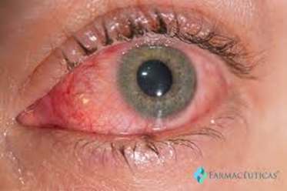
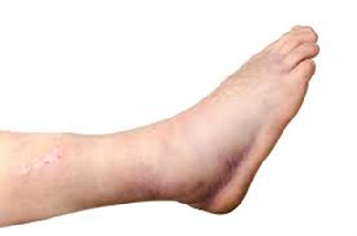
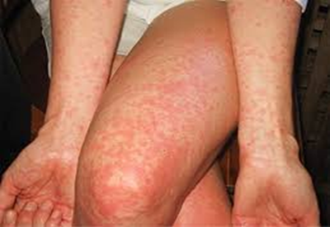
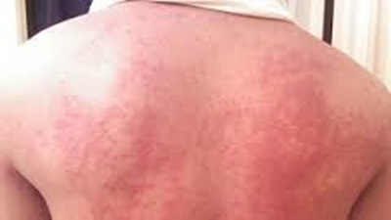
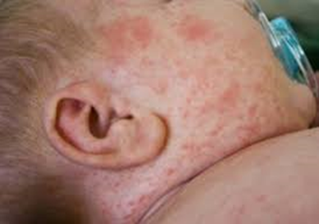
ZIKV Pathology
For 20% who report symptoms:
Fever
Rash (w/ itching)
Joint pain
Swelling of extremities
Red eyes (aka: conjunctivitis)
Differential Dx:
Dengue and Chikungunya

Slide 10
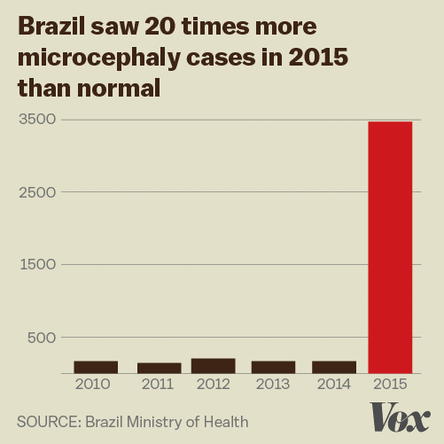
ZIKV Infection Complications
Microcephaly:
Birth Defect, in severe cases:
Abnormally small brains and heads
Seizures, developmental delays, motor skills issues, hearing and vision issues
Brazil went from 200/year to nearly 5,000
Guillain-Barre Syndrome (GBS):
Rare disorder where a person’s immune system damages their nerve cells
Muscle weakness, motor coordination issues, paralysis
Can last days to weeks

Slide 11
Current Status of ZIKV in the U.S. and NV
As of March 2, 2016, the CDC reports:
Travel-associated Cases:
153 confirmed cases of ZIKV
Reported from 29 states and one territory (PR)
Locally-acquired Cases:
Puerto Rico: 102
American Samoa: 4
U.S. Virgin Islands: 1
Nevada has had NO cases

Slide 12
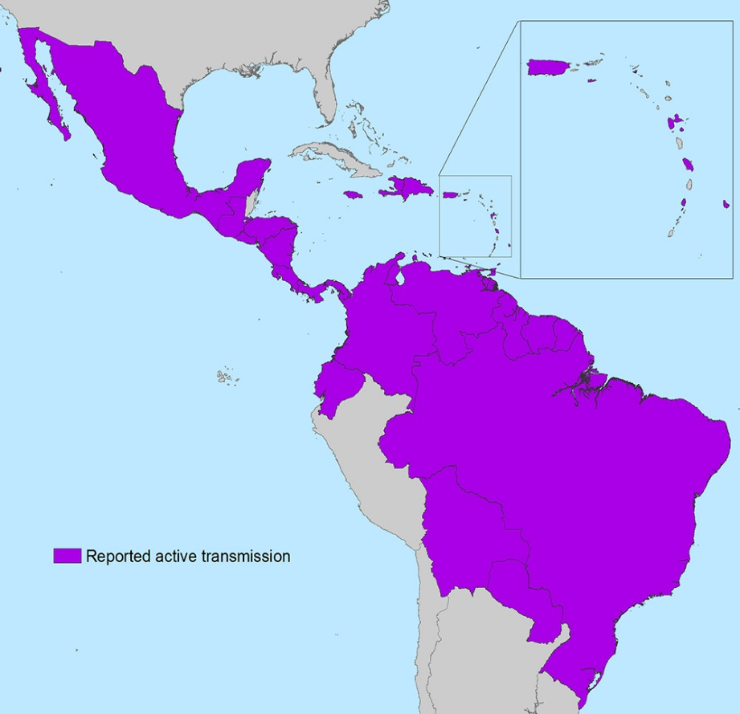
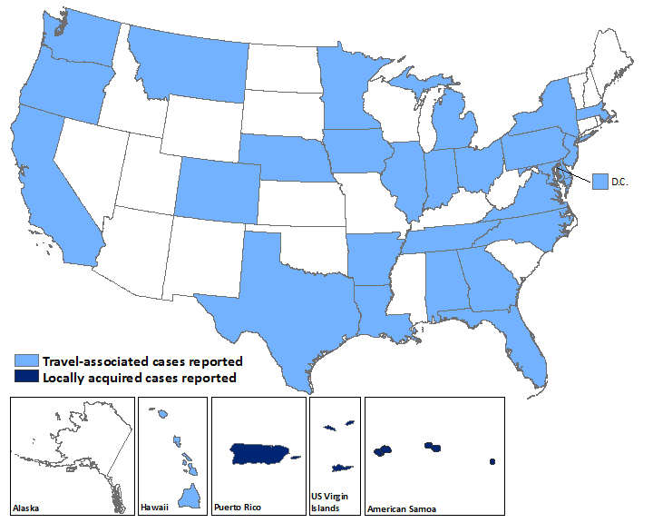
ZIKV Map
As of 3/2/16, updates can be found on: http://www.cdc.gov/zika/geo/united-states.html

Slide 13
ZIKV Projections for Nevada
Remember: Although Zika Virus is a new threat, it is very similar to Dengue and Chikungunya.
Use NV data for those as a proxy to help forecast:
Year | Dengue | Chikungunya
2010 | 4 | 0
2011 | 1 | 0
2012 | 2 | 0
2013 | 4 | 0
2014 | 3 | 0
2015 | 1 | 1
Totals: | 15* | 1*
* Note: 100% of these were travel-associated cases

Slide 14
How ZIKV is Being Addressed in Nevada
Disease Surveillance:
Human Population:
Zika Investigation Line List (as of 3/4/16)
21 samples submitted, all with travel history
CDC Laboratory handles serum samples, and tests for: 1) ZIKV, 2) Dengue, and 3) Chikungunya
Two negative test results (both women, one is pregnant)
Mosquito Population:
Mosquito traps and species typing throughout NV
Most of Aedes species are in the north
A. aegypti and A. albopictus do not currently live in NV
ZIKV shows a propensity for these two species

Slide 15
Potential Concerns for Nevadans
We will see import of human cases:
Remember Dengue and Chikungunya data
Vector import:
Unlikely, but remain vigilant through mosquito surveillance
Remember Yap Island A. hensilli example
WHO/PAHO Strategy:
Detect: Virus, its sequelae, and evolution of outbreak
Prevent: Reduce vector density, opps. for transmission
Respond: Healthcare, messaging, resource mobilization

Slide 16
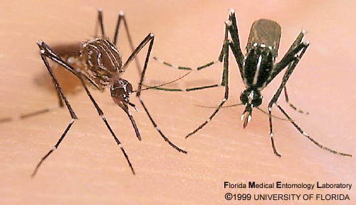
ZIKV Vectors
aegypti
Brown & white
Violin shape
Daytime biter
Bites multiple people in one feeding
Rests indoors
albopictus
Black & white
Aka: Asian tiger
White stripe down back
Leg stripes
Daytime biter
More common in N. America

Slide 17
Scientific Research
Remember: Up to 2007, there were 14 human cases
Science Needs Catch Up:
Correlation of microcephaly
Mutation of ZIKV
New vectors / new reservoirs
Incubation period
Survivor transmissibility
Sexual transmission
Interplay of Dengue/Chikungunya antibodies w/ ZIKV
Insecticide involvement

Slide 18
Resources
World Health Organization (WHO):
http://www.who.int/emergencies/zika-virus/en/
The U.S. Centers for Disease Control and Prevention (CDC):
http://www.cdc.gov/zika/index.html
The NV Division of Public & Behavioral Health (DPBH):
http://dpbh.nv.gov/
Click on “PROGRAMS” then “OPHIE”
Click “Public Health Informatics and Epidemiology”
Under Resources click “Training & Education”

Slide 19
QUESTIONS
Points of Contact:
Dr. Ihsan Azzam
State Medical Epidemiologist 775-684-5946 iazzam@health.nv.gov
Dan Mackie
State Epidemiologist
775-684-3229
dmackie@health.nv.gov

